Slide 1
CSCI 561 Foundations of Artificial Intelligence Lecture 4: Informed Search (Chapter 3)
Summer 2017
Instructor: Prof. Sheila Tejada

Slide 2
Notes:
a)DFS G1 (2%) _____ S­A­E­G1 ( 8%) [No partial credit]
b)UCS G3(2%) _____ S­C­D­B­G3( 8%) [No partial credit]
c)A* G3(2%) _____ S­B­C­D­G3 OR S­B­C­D­B­G3 (8%) [No partial credit]

Slide 3
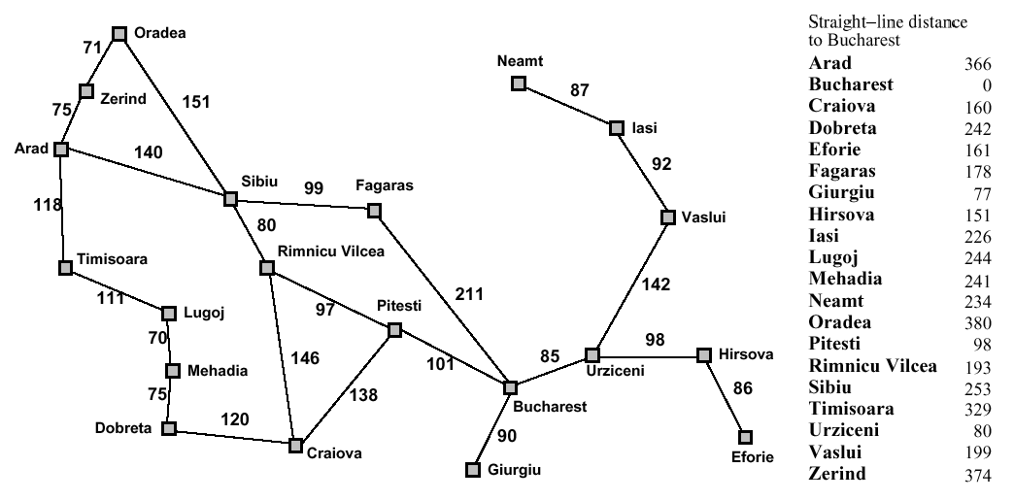
Map with SLD costs

Slide 4
Map with SLD costs

Slide 5
Map with SLD costs

Slide 6
Greedy best first search
Estimation function:
h(n) = estimate of cost from n to goal (heuristic)
For example:
h_{SLD}(n) = straight-line distance from n to Bucharest
Greedy search expands first the node that appears to be closest to the goal, according to h(n).

Slide 7
Greedy Best First Search: Arad to Bucharest

Slide 8
Greedy Best First Search: Arad to Bucharest

Slide 9
Greedy Best First Search: Arad to Bucharest

Slide 10
Greedy Best First Search: Arad to Bucharest

Slide 11
Greedy Best First Search: Arad to Bucharest

Slide 12
Greedy Search Evaluation
Completeness
No, can get stuck in loops. Complete in finite space with loop check.
Optimality
No, because ignores cost of reaching nodes (only looks forward)
Time complexity
Worst case is the same as depth first: O(b^{m})
E.g., if heuristic provides no (or counterproductive?) guidance
Hope is that average case is much better, but it can be difficult to analyze how much gain a heuristic provides on average
Space complexity
Maintains a priority queue of the fringe: O(b^{m})
Average case should be better here as well
Notes:
Not complete because if, for example, heuristic is real bad it could have you lost in an irrelevant but infinite subspace.

Slide 13
A* Search
Idea
Avoid expanding paths that are already expensive
Use (approximate) total path cost to guide search
Evaluation function f(n) = g(n) + h(n)
g(n) the cost (so far) to reach the node
h(n) estimated cost to get from node to goal
f(n) estimated total cost of path through n to goal
Big improvement on greedy best-first search
With admissible heuristics, can guarantee optimality

Slide 14
Admissible Heuristics
A heuristic is admissible if it never overestimates the cost to reach the goal
Admissible heuristics are “optimistic”
Formally:
1. h(n) ≤ h*(n) where h*(n) is the true cost from n
2. h(n) ≥ 0, with h(G)=0 for any goal G
e.g. h_{SLD}(n) is admissible because it never overestimates the actual road distance

Slide 15
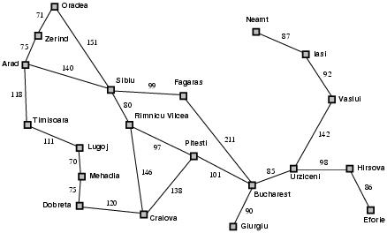
A* Example: Arad ⇒ Bucharest
○
○
○
Start with Arad
f(Arad) = c(UND,Arad)+h(Arad)=0+366=366

Slide 16
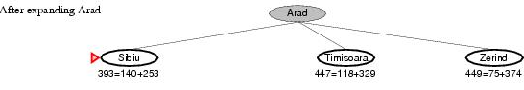
A* Example: Arad ⇒ Bucharest
○
○
○
Expand Arrad and determine f(n) for each node
f(Sibiu)=c(Arad,Sibiu)+h(Sibiu)=140+253=393
f(Timisoara)=c(Arad,Timisoara)+h(Timisoara)=118+329=447
f(Zerind)=c(Arad,Zerind)+h(Zerind)=75+374=449
Best choice is Sibiu

Slide 17
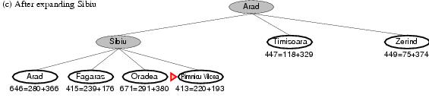
A* Example: Arad ⇒ Bucharest
○
○
○
○
Expand Sibiu and determine f(n) for each node
f(Arad)=c(Sibiu,Arad)+h(Arad)=280+366=646
f(Fagaras)=c(Sibiu,Fagaras)+h(Fagaras)=239+179=415
f(Oradea)=c(Sibiu,Oradea)+h(Oradea)=291+380=671
f(Rimnicu Vilcea)=c(Sibiu,Rimnicu Vilcea)+h(Rimnicu Vilcea)=220+192=413
Best choice is Rimnicu Vilcea

Slide 18
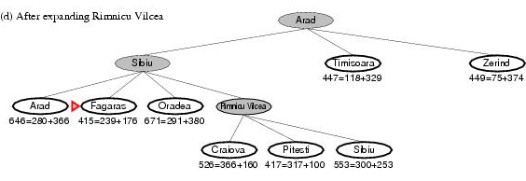
A* Example: Arad ⇒ Bucharest
○
○
○
○
Expand Rimnicu Vilcea and determine f(n) for each node
f(Craiova)=c(Rimnicu Vilcea, Craiova)+h(Craiova)=360+160=526
f(Pitesti)=c(Rimnicu Vilcea, Pitesti)+h(Pitesti)=317+100=417
f(Sibiu)=c(Rimnicu Vilcea,Sibiu)+h(Sibiu)=300+253=553
Best choice is Fagaras

Slide 19
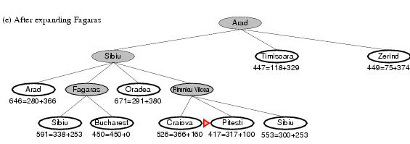
A* Example: Arad ⇒ Bucharest
○
○
○
○
Expand Fagaras and determine f(n) for each node
f(Sibiu)=c(Fagaras, Sibiu)+h(Sibiu)=338+253=591
f(Bucharest)=c(Fagaras,Bucharest)+h(Bucharest)=450+0=450
Best choice is Pitesti!!!

Slide 20
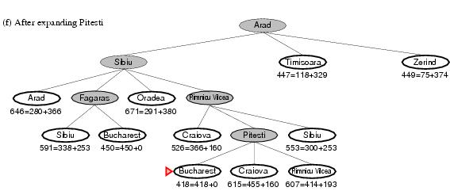
A* Example: Arad ⇒ Bucharest
○
○
○
○
Expand Pitesti and determine f(n) for each node
f(Bucharest)=c(Pitesti,Bucharest)+h(Bucharest)=418+0=418 [others omitted]
Best choice is Bucharest (from Pitesti)!!!
Optimal solution (only if h(n) is admissible)

Slide 21
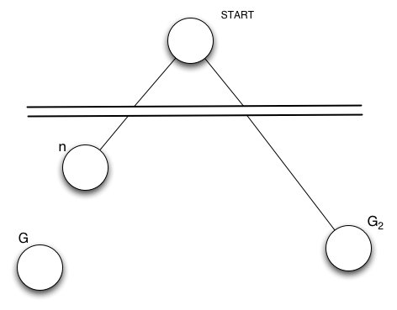
Optimality of A*: Standard Proof
n
G
G2
Suppose suboptimal goal G₂ in the queue
Let n be any unexpanded node on shortest path to optimal goal G
f(G₂ ) = g(G₂ ) since h(G₂ )=0
> g(G) since G₂ is suboptimal
≥ f(n) since h is admissible
Since f(G₂) > f(n), A* will never select G₂ for expansion

Slide 22
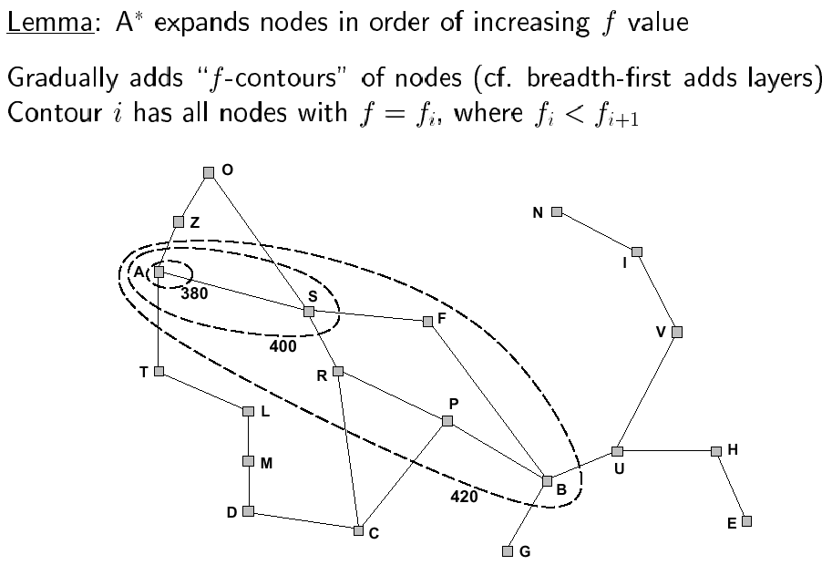
Contours

Slide 23
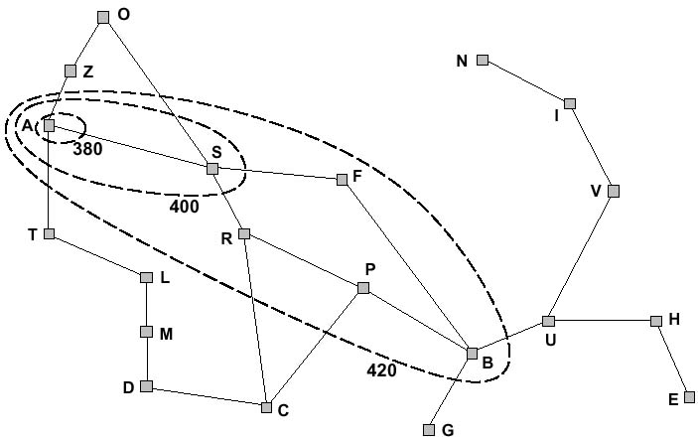
f-contours
How do the contours look like when h(n) =0?

Slide 24
A* Evaluation
Completeness
YES, since nodes are added in concentric bands of f
If admissible (tree) or consistent (graph)
Unless there are infinitely many nodes with f(n) < f(G)
Optimality
YES, under similar conditions to completeness
Time complexity
Exponential
A* expands all nodes with f(n)< C* (C* is cost of optimal path)
A* expands some nodes with f(n)=C*
A* expands no nodes with f(n)>C*
Optimally efficient: No other algorithm can guarantee fewer nodes
Space complexity
Exponential
Still the dominant problem (rather than time complexity)
Notes:
C* is cost of optimal solution

Slide 25
Notes:
a)DFS G1 (2%) _____ S­A­E­G1 ( 8%) [No partial credit]
b)UCS G3(2%) _____ S­C­D­B­G3( 8%) [No partial credit]
c)A* G3(2%) _____ S­B­C­D­G3 OR S­B­C­D­B­G3 (8%) [No partial credit]

Slide 26

More on Heuristic Functions
Primary point is to reduce nodes visited
For eight puzzle without heuristics:
Average solution path is ~22 steps and branching factor ~3
Exhaustive search would visit ~10¹⁰ states
Two eight-puzzle heuristics we have already talked about:
h₁ = number of misplaced tiles
h₂ = sum of distances of tiles from their goal positions
Manhattan distance
But how good are they, and how do we invent them?

Slide 27
Some Eight Puzzle Data
1200 random problems w/ solution lengths of 2-24
Overall, h₂ looks better than h₁
But is it always better?
Notes:
IDS is standard Iterative-Deepening depth-first Search

Slide 28
Inventing Admissible Heuristics
Admissible heuristics can be derived from exact solution costs of relaxed/abstract versions of problems
A relaxed problem eliminates applicability restrictions on operators
Two eight puzzle examples
Enable tile to move into any adjacent square (whether or not blank)
Exact solution costs in this problem yield heuristic h₂
Enable tile to move to any square in one step (whether or not blank or adjacent)
Exact solution costs in this problem yield heuristic h₁
The optimal solution cost of a relaxed problem is no greater than the optimal solution cost of the real problem

Slide 29
Exercise 3.14
Which of the following are true and which are false? Explain your answers.
Depth-first search always expands at least as many nodes as A∗ search with an admissible heuristic.
h(n) = 0 is an admissible heuristic for the 8-puzzle.
A∗ is of no use in robotics because percepts, states, and actions are continuous.
Breadth-first search is complete even if zero step costs are allowed.
Assume that a rook can move on a chessboard any number of squares in a straight line, vertically or horizontally, but cannot jump over other pieces. Manhattan distance is an admissible heuristic for the problem of moving the rook from square A to square B in the smallest number of moves.
Notes:
False: a lucky DFS might expand exactly d nodes to reach the goal. A∗ largely dominates any graph-search algorithm that is guaranteed to find optimal solutions.
True: h(n) = 0 is always an admissible heuristic, since costs are nonnegative.
False: A* search is often used in robotics; the space can be discretized or skeletonized.
True: depth of the solution matters for breadth-first search, not cost.
False: a rook can move across the board in move one, although the Manhattan distance
from start to finish is 8.

Slide 30
Artificial Intelligence Beyond Classical Search Chapter 4 [except 4.2])

Slide 31
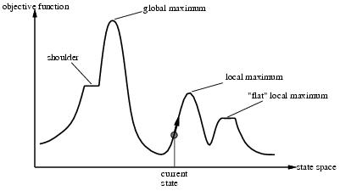
Hill Climbing
Move continuously in the direction of increasing value
Go to best successor of current state, based on evaluation
If more than one best successor, pick randomly among them
Terminate when reach a peak
May only find a local maximum
This form of hill climbing is also referred to as
Steepest-ascent hill climbing
Greedy local search
Continuous analogue is gradient ascent
Notes:
One dimensional space

Slide 32
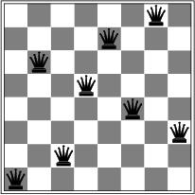
N-Queens problem
Works quickly
3-4 steps on average with state space of 8⁸ ≈ 17 million states
Plateaus can lead to wandering
An area of the state space where the evaluation function is flat
Ridges can make things very difficult
Sequence of local maxima difficult for greedy algorithms to navigate
Notes:
What is h?
Can’t reduce in one step because already one queen in each row

Slide 33
Hill Climbing
What are the advantages and disadvantages of classical hill-climbing?
Can you think of real-world examples where hill-climbing would be particularly good?
What about bad?
Notes:
The success of hill climbing depends very much on the shape of the state-space land- scape: if there are few local maxima and plateaux, random-restart hill climbing will find a good solution very quickly. On the other hand, many real problems have a landscape that looks more like a widely scattered family of balding porcupines on a flat floor, with miniature porcupines living on the tip of each porcupine needle, ad infinitum. NP-hard problems typically have an exponential number of local maxima to get stuck on. Despite this, a reasonably good local maximum can often be found after a small number of restarts.

Slide 34
Local beam search
1. Start with k randomly generated nodes.
2. Generate all successors of each of the k.
3. Keep the best k out of the them.
4. Repeat till goal or stop condition reached
K=2
K=2
Notes:
What is local beam search?
It begins with k randomly generated states. At each step, all the successors of all k states are generated. If any one is a goal, the algorithm halts. Otherwise, it selects the k best successors from the complete list and repeats.
At first sight, a local beam search with k states might seem to be nothing more than running k random restarts in parallel instead of in sequence. In fact, the two algorithms are quite different. In a random-restart search, each search process runs independently of the others. In a local beam search, useful information is passed among the parallel search threads. In effect, the states that generate the best successors say to the others, “Come over here, the grass is greener!” The algorithm quickly abandons unfruitful searches and moves its resources to where the most progress is being made.
In its simplest form, local beam search can suffer from a lack of diversity among the k states—they can quickly become concentrated in a small region of the state space, making the search little more than an expensive version of hill climbing. A variant called stochastic beam search, analogous to stochastic hill climbing, helps alleviate this problem. Instead of choosing the best k from the the pool of candidate successors, stochastic beam search chooses k successors at random, with the probability of choosing a given successor being an increasing function of its value. Stochastic beam search bears some resemblance to the process of natural selection, whereby the “successors” (offspring) of a “state” (organism) populate the next generation according to its “value” (fitness).

Slide 35
Simulated Annealing
Escape local maxima by allowing “bad” moves
The worse the move the less likely it is to be chosen
Gradually decrease likelihood of bad moves over time
Ball analogy (assumes going for minimum)
Ball rolls to lower regions
Shaking (temperature/vibrations) can move it to higher
If T decreases slowly enough, optimal state is reached

Slide 36
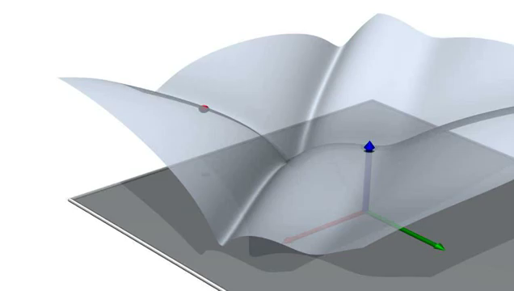

Slide 37
Simulated Annealing Algorithm Based on Maximization
function SIMULATED-ANNEALING(problem, schedule) return a solution state
input: problem, a problem
schedule, a mapping from time to temperature
current ← MAKE-NODE(problem.INITIAL-STATE)
for t ← 1 to ∞ do
T ← schedule(t)
if T = 0 then return current
next ← a randomly selected successor of current
∆E ← next.VALUE – current.VALUE
if ∆E > 0 then current ← next
else current ← next, only with probability e^{∆E/T}
Variant of stochastic hill climbing where can also go downhill
Notes:
This variant freezes all moves when T=0 rather than just freezing out uphill moves

Slide 38

Genetic Algorithms

Slide 39


Example: Traveling Sales Person
Classic Example: You have N cities, find the shortest route such that your salesperson will visit each city once and return.
This problem is known to be NP-Hard
As a new city is added to the problem, computation time in the classic solution increases exponentially O(2^{n}) … (as far as we know)
Dallas
Is this the shortest path???
Austin
Houston
Mos Eisley
San Antonio
A Texas Sales Person

Slide 40
Represent problem like a DNA sequence
Each DNA sequence is a
possible solution to the
problem.
DNA - Salesperson A
Dallas
Houston
Mos Eisely
San Antonio
Austin
San Antonio
Dallas
Mos Eisely
Houston
Austin
DNA - Salesperson B
The order of the cities in
the genes is the order of
the cities the TSP will take.
Notes:
One the fitness has been assigned, pairs of chromosomes representing heat exchanger designs can be chosen for mating.
The higher the fitness, the greater the probability of the design being selected. Consequently, some of the weaker population members do not mate at all, whilst superior ones are chosen many times.
It is even statistically possible for a member to be chosen to mate with itself. This has no advantage, as the offspring will be identical to the parent.

Slide 41
Crossover
Not all crossed pairs are viable. We can only visit a city once.
Different GA problems may have different bounds.
Parents
Children
Dallas
Houston
Austin
San Antonio
Mos Eisely
San Antonio
Dallas
Mos Eisely
Houston
Austin
San Antonio
Dallas
Austin
San Antonio
Mos Eisely
Dallas
Houston
Mos Eisely
Houston
Austin
Not Viable!!

Slide 42
The Genetic Algorithm Cycle
New Population
Fitness
Selection
Mutation
Crossover
Notes:
Summary of the previous steps to the model.
Populations are continuously produced, going round the outer loop of this diagram, until the desired amount of optimisation has been achieved.

Slide 43
Genetic algorithm
“A genetic algorithm is a variant of stochastic beam search in which successor states are generated by combining two parent states rather than by modifying a single state.”
What might be possible advantages of this approach over stochastic beam search?
For what kinds of problems is a genetic algorithm approach appropriate? When not? Why?
K=2

Slide 44
Exercise 4.1
Give the name of the algorithm that results from each of the following special cases:
Local beam search with k = 1.
Local beam search with one initial state and no limit on the number of states retained.
Simulated annealing with T = 0 at all times (and omitting the termination test).
Simulated annealing with T = ∞ at all times.
Genetic algorithm with population size N = 1.
Hill Climbing
BFS
Hill Climbing
Random
Walk
Random Walk
Notes:
Local beam search with k = 1 is hill-climbing search.
Local beam search with one initial state and no limit on the number of states retained, resembles breadth-first search in that it adds one complete layer of nodes before adding the next layer. Starting from one state, the algorithm would be essentially identical to breadth-first search except that each layer is generated all at once.
Simulated annealing with T = 0 at all times: ignoring the fact that the termination step would be triggered immediately, the search would be identical to first-choice hill climb- ing because every downward successor would be rejected with probability 1. (Exercise may be modified in future printings.)
Simulated annealing with T = ∞ at all times is a random-walk search: it always accepts a new state.
Genetic algorithm with population size N = 1: if the population size is 1, then the two selected parents will be the same individual; crossover yields an exact copy of the individual; then there is a small chance of mutation. Thus, the algorithm executes a random walk in the space of individuals.

Slide 45
Next Time
Adversarial Search (Games) (Chapter 5)
Constraint Satisfaction Problems (Chapter 6)
Practice Exercises:
Chapter 4: # 4.1
Chapter 6: # 6.1, 6.5

